Slide 1
Internet Reference Models

Slide 2
Reference Model
Reference Model offers a means of standardization which is acceptable worldwide. Since people using the computer network are located over a wide physical range and their network devices might have heterogeneous architecture.
In order to provide communication among heterogeneous devices, we need a standardized model i.e. a reference model, which would provide us way how these devices can communicate regardless their architecture.
We have two reference models such as OSI model and TCP/IP reference model, however, the OSI model is a hypothetical one but the TCP/IP is absolutely practical model.

Slide 3
OSI Model
OSI is acronym of Open System Interface. This model is developed by the International organization of Standardization (ISO) and therefore also referred as ISO-OSI Model.
The OSI model consists of seven layers as shown in the following diagram. Each layer has a specific function, however each layer provide services to the layer above.

Slide 4
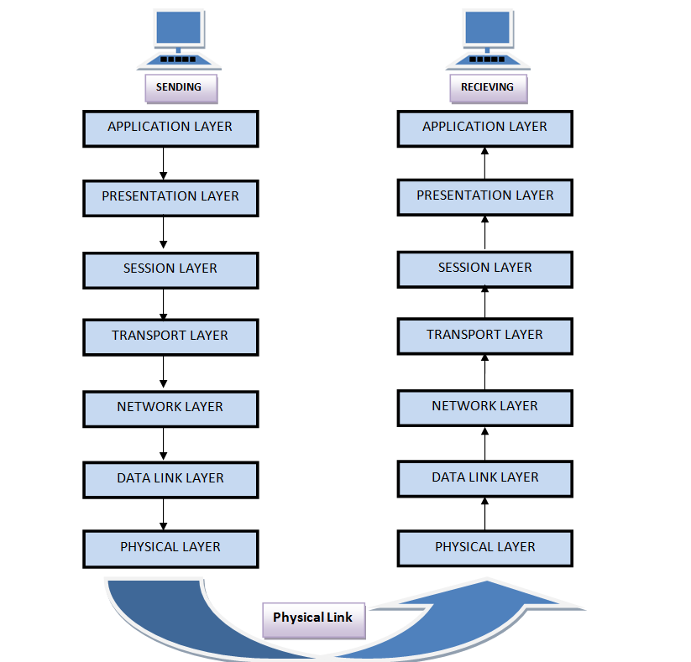

Slide 5
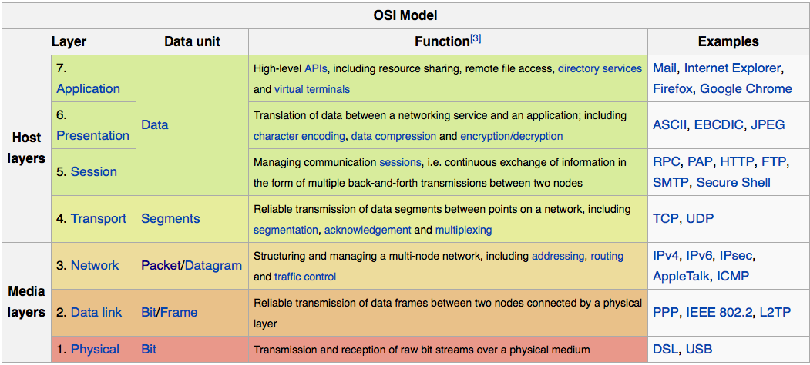

Slide 6
Feature of OSI Model
Big picture of communication over network is understandable through this OSI model.
We see how hardware and software work together.
We can understand new technologies as they are developed.
Troubleshooting is easier by separate networks.
Can be used to compare basic functional relationships on different networks.

Slide 7
The Physical Layer
It is the lowest layer of the OSI Model.
It activates, maintains and deactivates the physical connection.
It is responsible for transmission and reception of the unstructured raw data over network.
Voltages and data rates needed for transmission is defined in the physical layer.
It converts the digital/analog bits into electrical signal or optical signals.
Data encoding is also done in this layer.

Slide 8
Data Link Layer
Data link layer synchronizes the information which is to be transmitted over the physical layer.
The main function of this layer is to make sure data transfer is error free from one node to another, over the physical layer.
Transmitting and receiving data frames sequentially is managed by this layer.
This layer sends and expects acknowledgements for frames received and sent respectively. Resending of non-acknowledgement received frames is also handled by this layer.
This layer establishes a logical layer between two nodes and also manages the Frame traffic control over the network. It signals the transmitting node to stop, when the frame buffers are full.

Slide 9
The Network Layer
It routes the signal through different channels from one node to other.
It acts as a network controller. It manages the Subnet traffic.
It decides by which route data should take.
It divides the outgoing messages into packets and assembles the incoming packets into messages for higher levels.

Slide 10
Transport Layer
It decides if data transmission should be on parallel path or single path.
Functions such as Multiplexing, Segmenting or Splitting on the data are done by this layer
It receives messages from the Session layer above it, convert the message into smaller units and passes it on to the Network layer.
Transport layer can be very complex, depending upon the network requirements.
Transport layer breaks the message (data) into small units so that they are handled more efficiently by the network layer.

Slide 11
The Session Layer
Session layer manages and synchronize the conversation between two different applications.
Transfer of data from source to destination session layer streams of data are marked and are resynchronized properly, so that the ends of the messages are not cut prematurely and data loss is avoided.

Slide 12
The Presentation Layer
Presentation layer takes care that the data is sent in such a way that the receiver will understand the information (data) and will be able to use the data.
While receiving the data, presentation layer transforms the data to be ready for the application layer.
Languages(syntax) can be different of the two communicating systems. Under this condition presentation layer plays a role of translator.
It performs Data compression, Data encryption, Data conversion etc.

Slide 13
Application Layer
It is the topmost layer.
Transferring of files disturbing the results to the user is also done in this layer. Mail services, directory services, network resource etc are services provided by application layer.
This layer mainly holds application programs to act upon the received and to be sent data.

Slide 14
Merits of OSI reference model:
OSI model distinguishes well between the services, interfaces and protocols.
Protocols of OSI model are very well hidden.
Protocols can be replaced by new protocols as technology changes.
Supports connection oriented services as well as connectionless service.

Slide 15
Demerits of OSI reference model:
Model was devised before the invention of protocols.
Fitting of protocols is tedious task.
It is just used as a reference model.

